Slide 1
EasyReg
M4 – Final Presentation
Universidade de Aveiro - DETI - June 2025

Slide 2
Table of Contents
01
02
03
04
Context
State of the Art
Requirements
Actors
05
06
07
08
Use Cases
Architecture
Interfaces
Our thoughts
2

Slide 3

EasyReg aims to simplify and automate compliance tracking, ensuring organizations meet their security obligations efficiently
3

Slide 4
Context
Multiple Compliance Requirements
Organizations need to work across multiple frameworks, each with its own compliance requirements, resulting in significant complexity in managing the process.
Need for an Integrated Solution
There is a demand for a centralized platform that automates the tracking and management of requirements, optimizing workflows and ensuring security.
Manual Processes and Risks
Manual evidence collection and audit execution increase the risk of inconsistencies and errors, while also requiring significant operational effort.
4

Slide 5
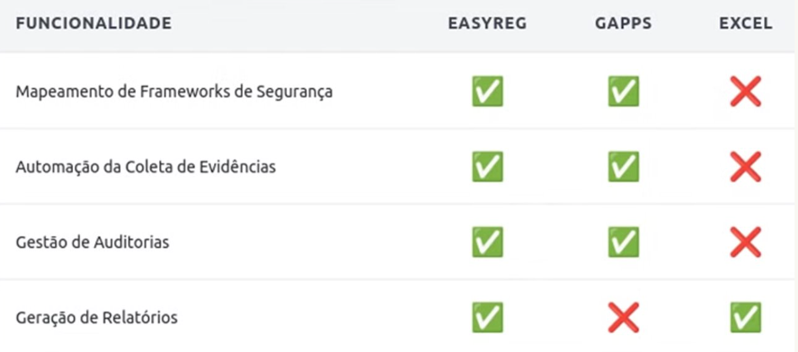
State of the Art
5

Slide 6




Functional Requirements
Authentication, Authorization and Security
Audits Management
Accessible Evidences
Compliance Information
6

Slide 7



Actors
Contributor
Internal Auditor
with 5 User Stories
with 2 User Stories
Company Owner
External Auditor
with 7 User Stories
with 3 User Stories
7

Slide 8
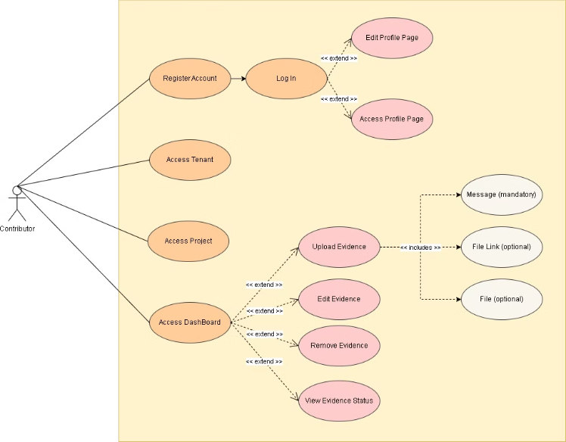
Use Cases – Contributor
8

Slide 9
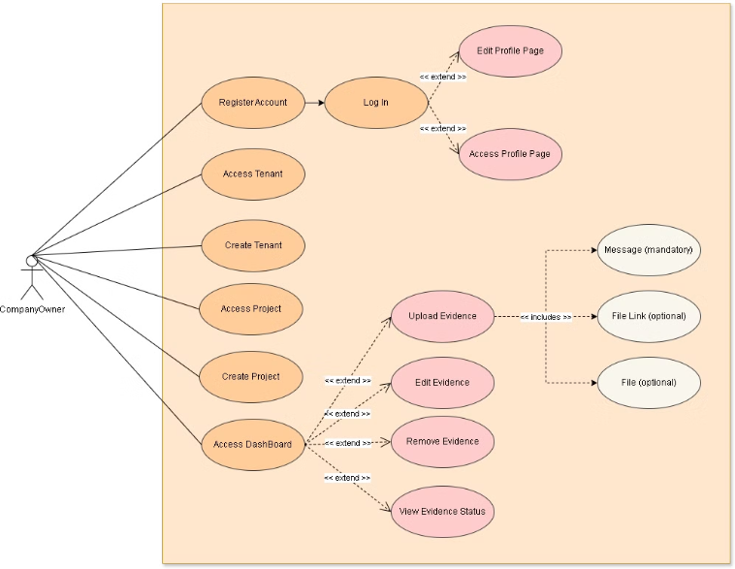
Use Cases – Company Owner
9

Slide 10
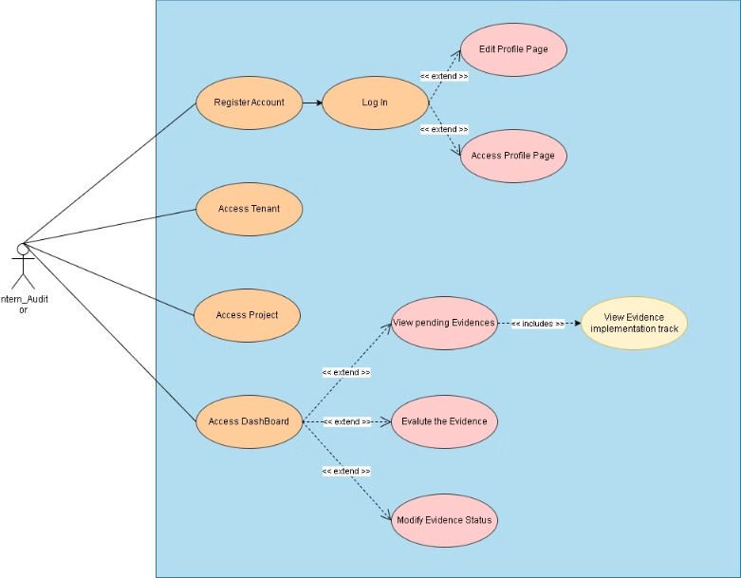
Use Cases – Internal Auditor
10

Slide 11
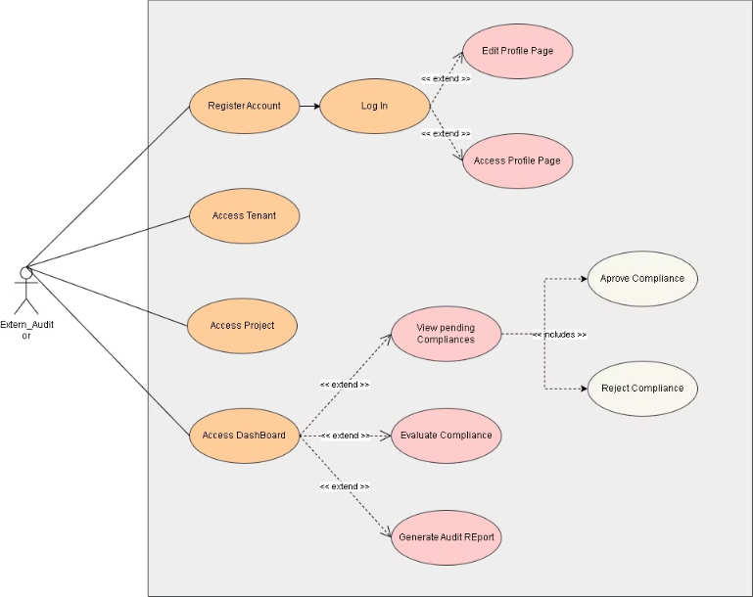
Use Cases – External Auditor
11

Slide 12
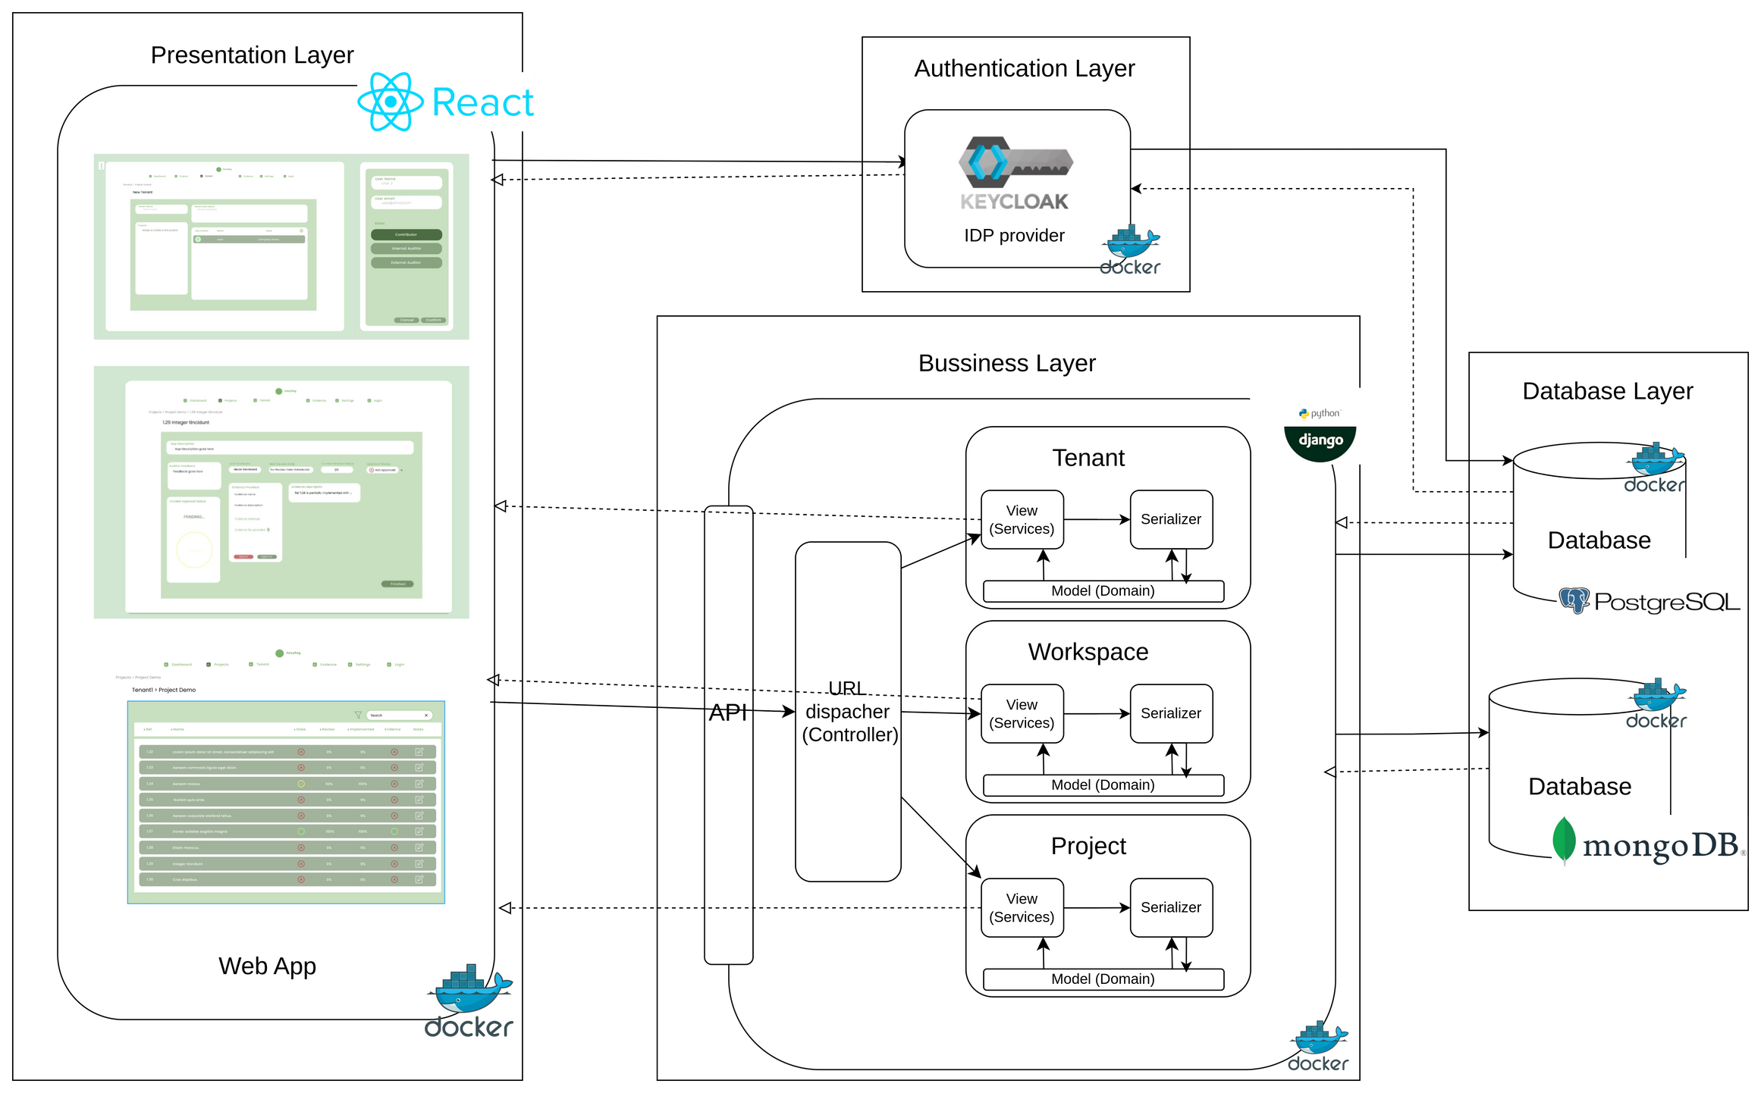
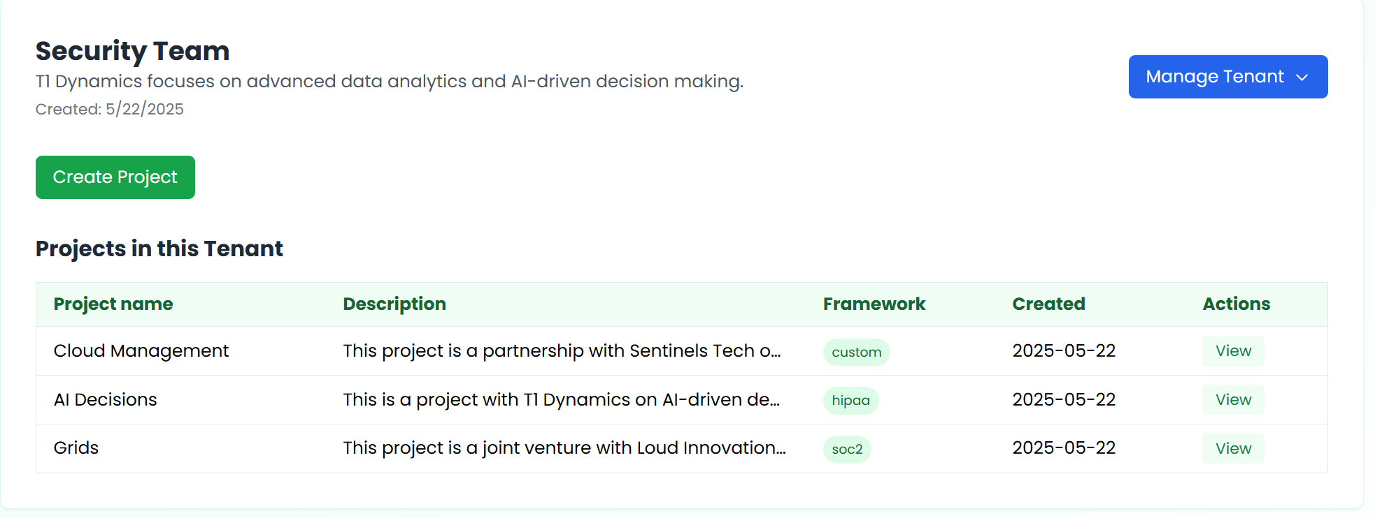
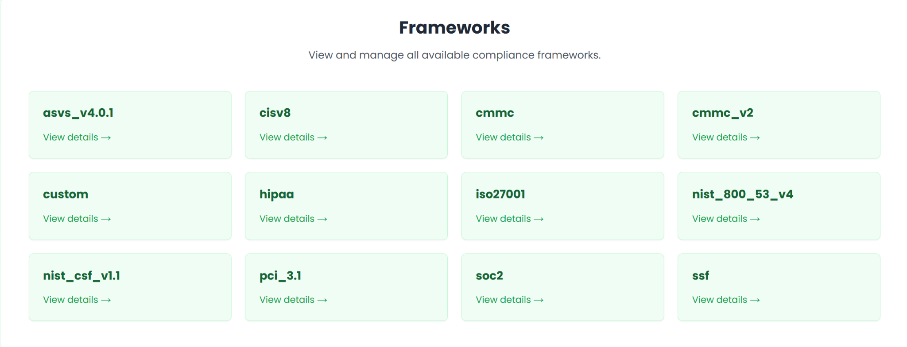
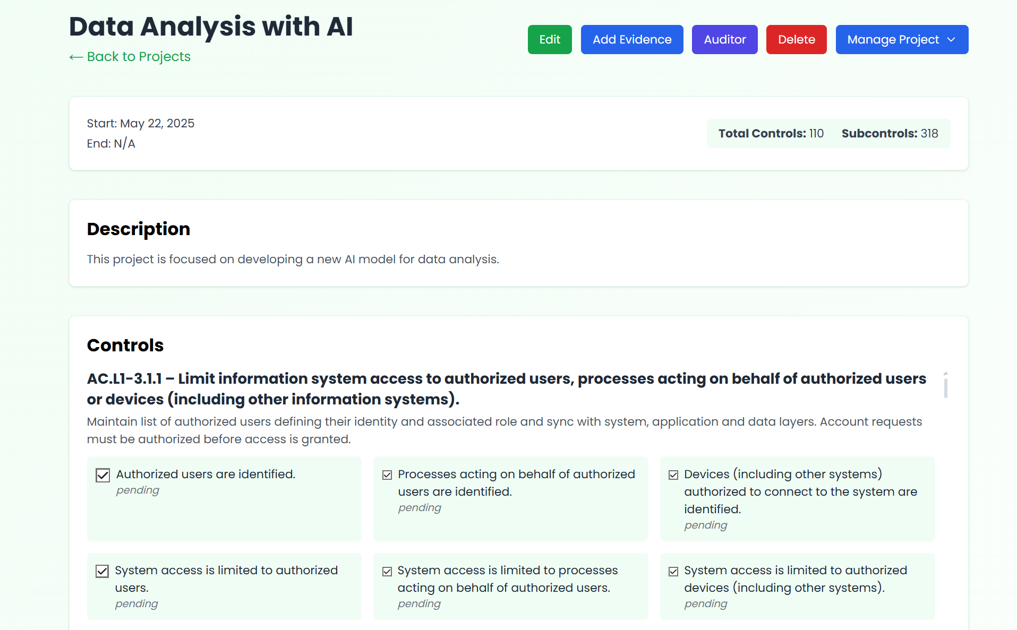
Architecture
12

Slide 13
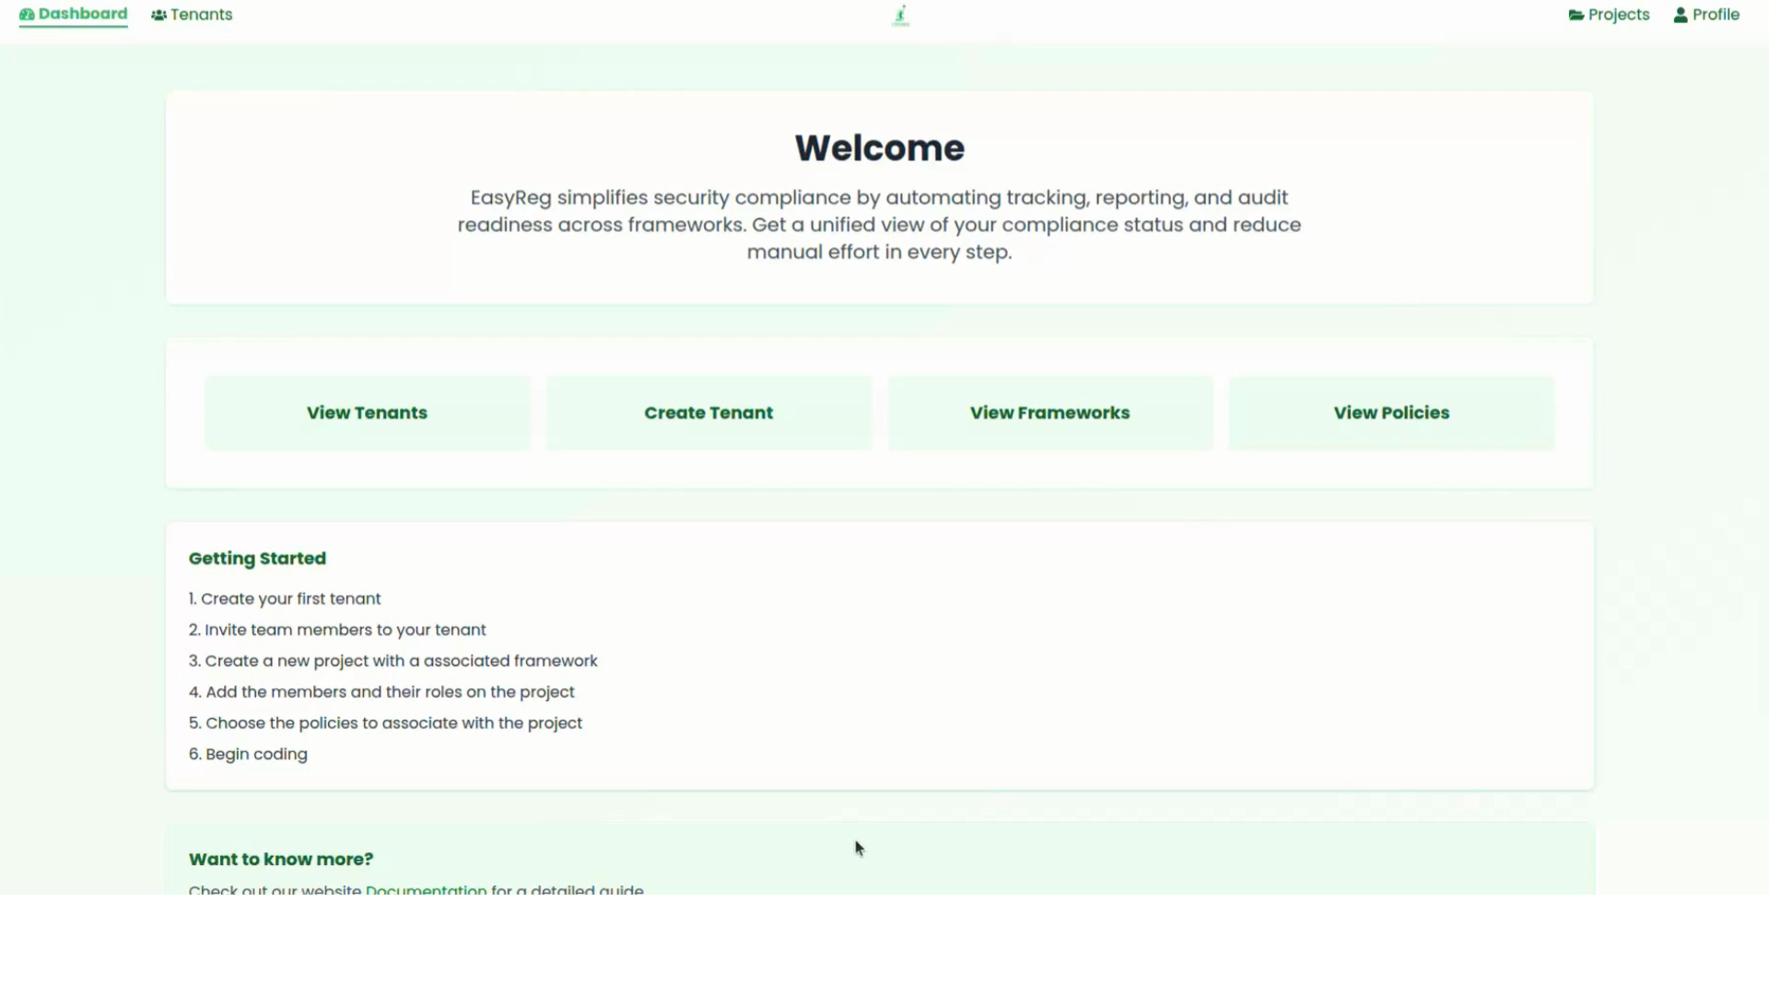
Company Owner Interface
13

Slide 14
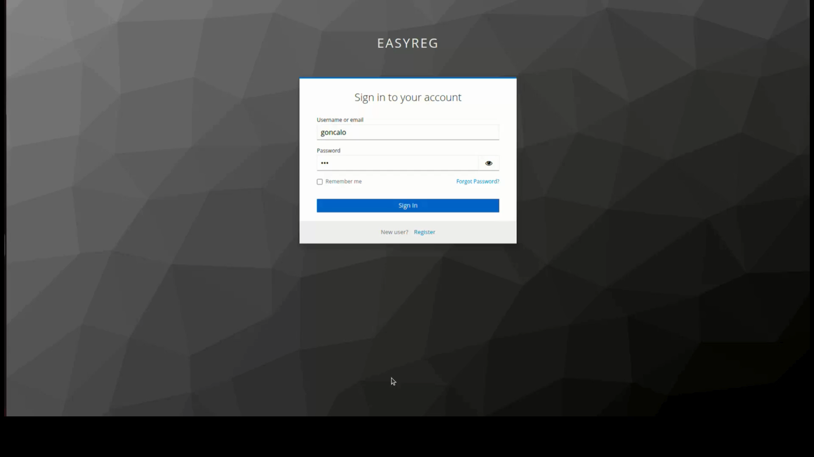
Contributor Interface
14

Slide 15
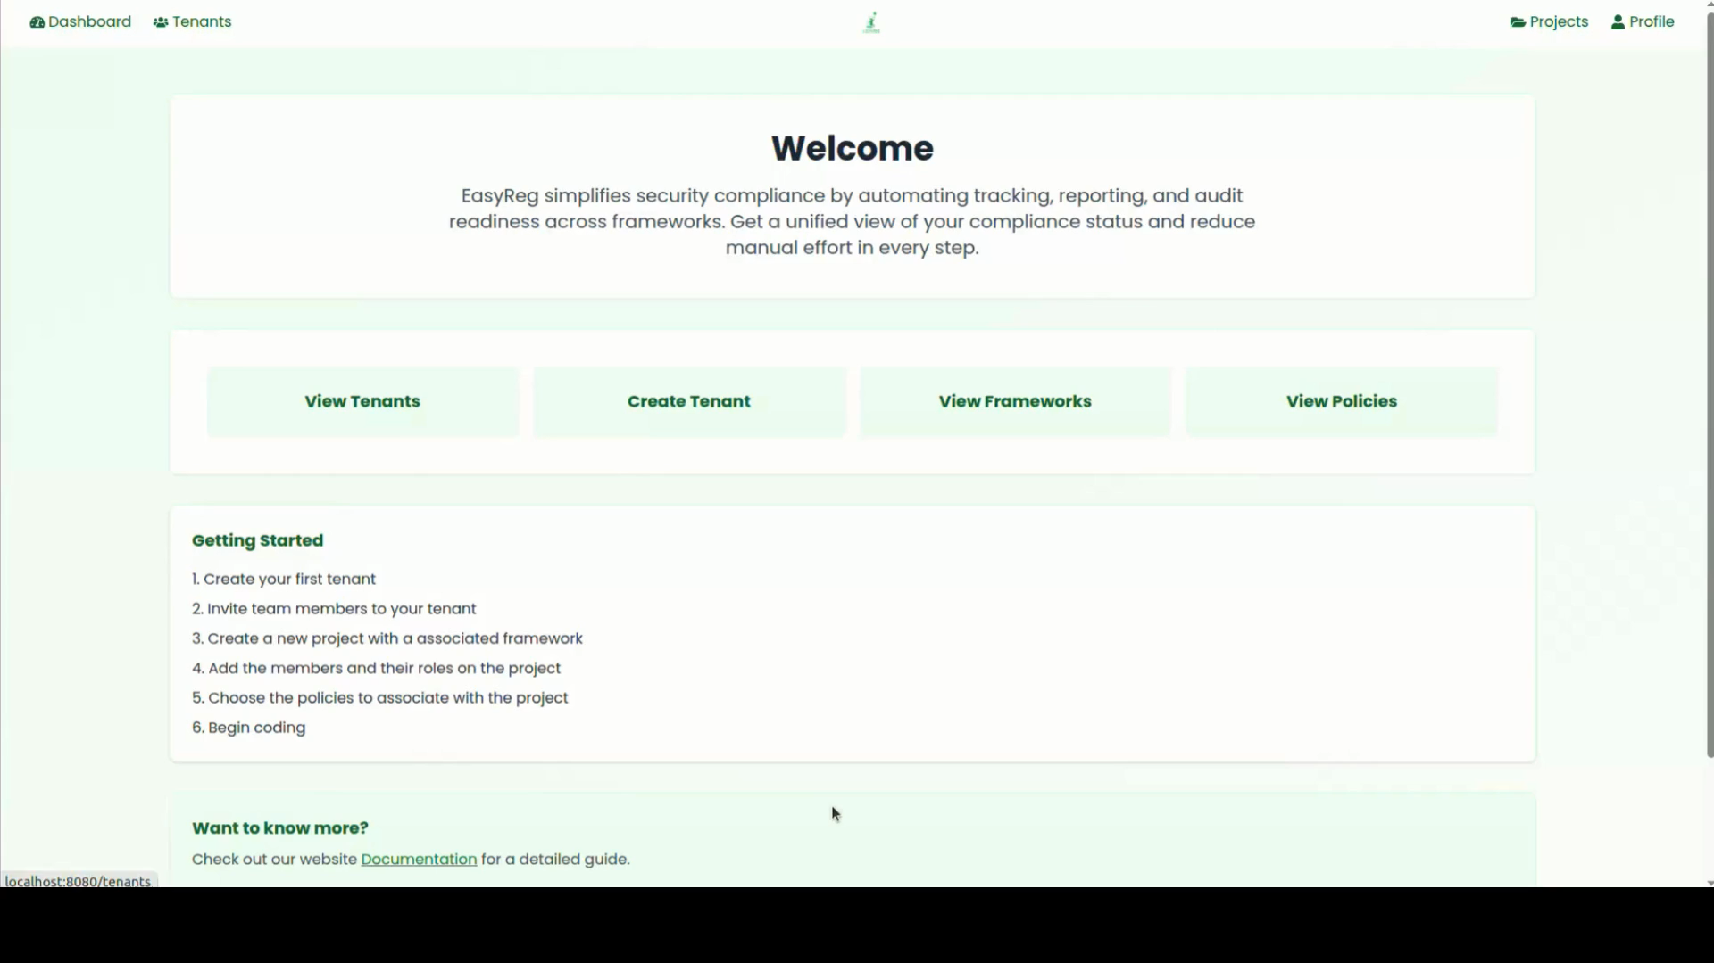
Internal Auditor Interface
15

Slide 16
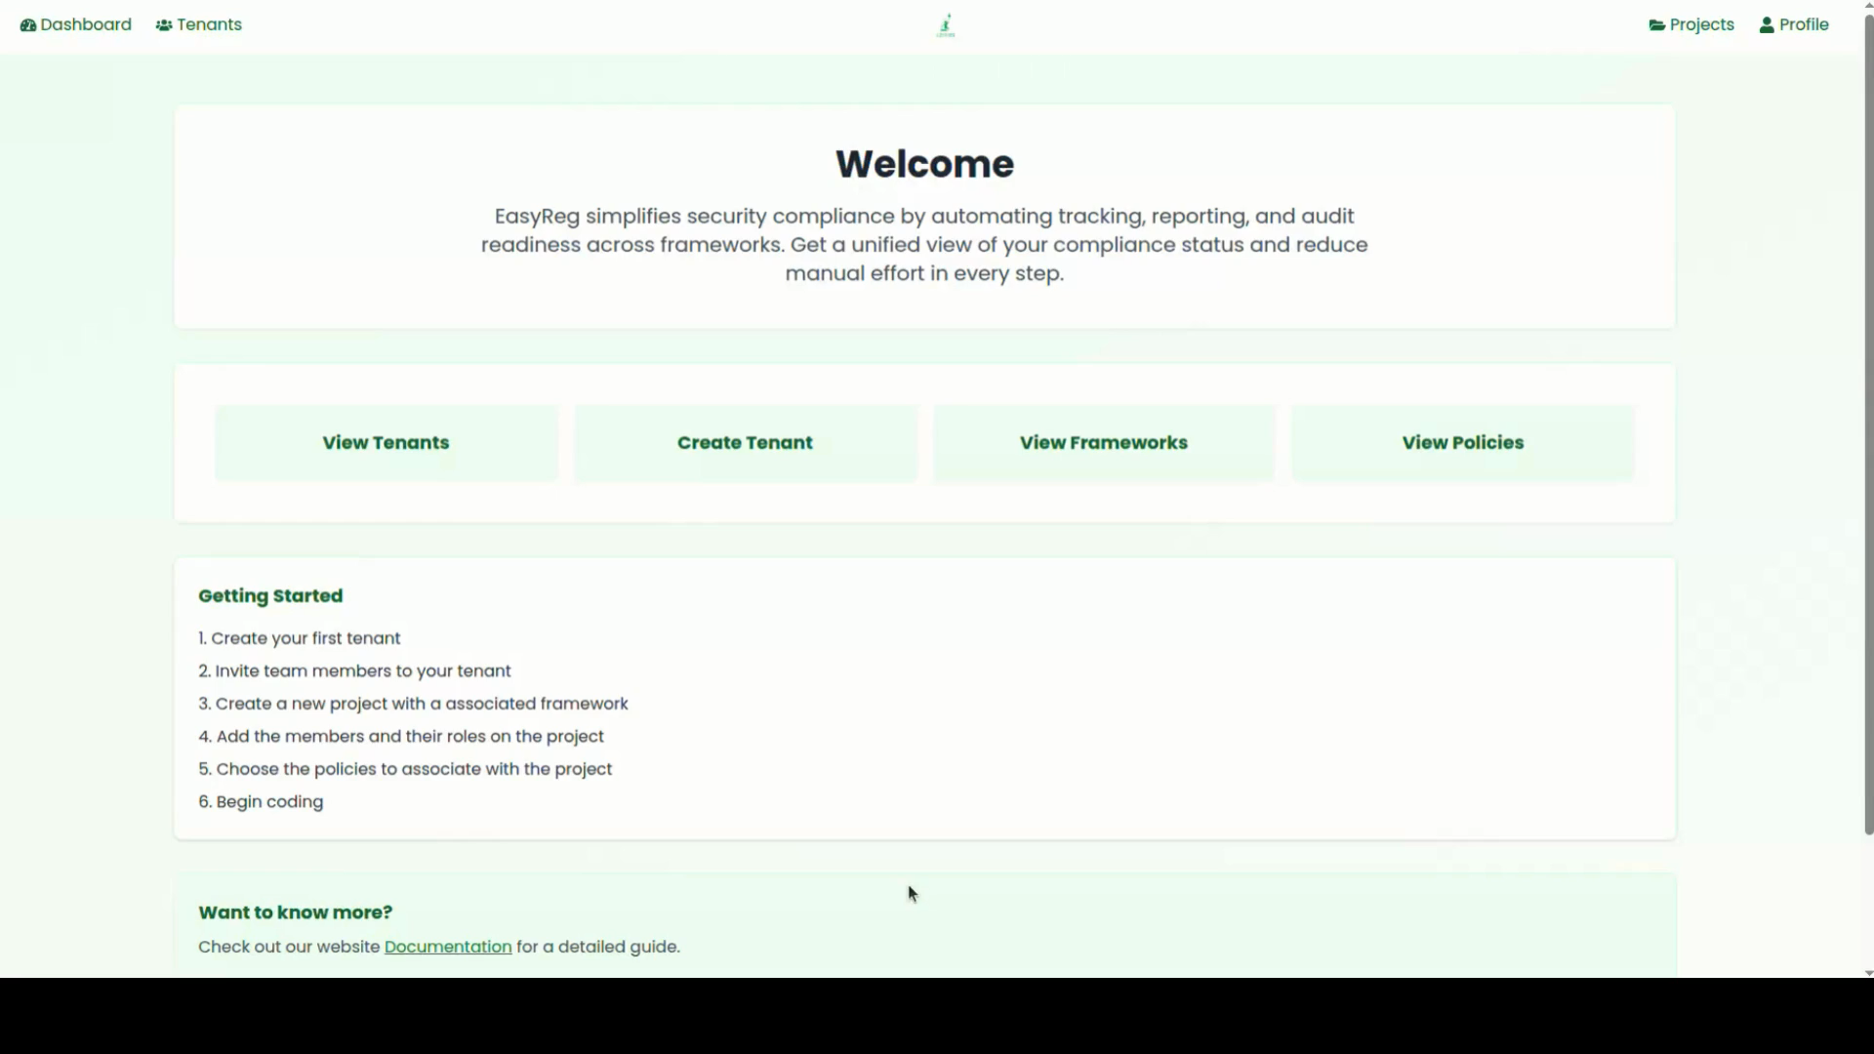
External Auditor Interface
16

Slide 17
Main struggles during the project
Contextualization of the concepts that were used in the project including but not only frameworks, policies, controls and subcontrols.
Keycloak integration both in the frontend as the backend.
Modeling of the databases that were used mainly in the backend
17

Slide 18
What we think of EasyReg
Positive Aspects
Efficient: Automated tracking and reporting helps efficiency.
Centralized Platform: Optimized workflow reduces loss of time.
Delegation of Roles: Assigned roles helps with workflow and user accountability.
Audit Readiness: Simplifies documentation and evidence management.
Areas for improvement
Scalability: Needs optimization for large-scale implementations.
User Experience (UX): Potential enhancements for non-technical users.
18

Slide 19
What we learned
Technical Aspects
Full-stack development
Api integration
Compliance logic
Project & Team Aspects
Team Collaboration
Project Management
Problem-solving
Real world awareness
Importance of compliance
Importance of user-centric design
19

Slide 20
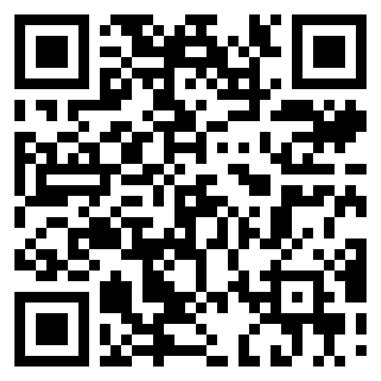
Micro-Site
Thank you!
Team:
Ana Loureiro 104063
Filipe Oliveira 114640
Gonçalo Monteiro 107758
Miguel Francisco 108304
Miguel Pinto 108481
Advisors:
Prof. João Rafael Almeida Mariana Andrade
20

